Slide 1
Chapter 4 (Section 4.3, …) 2nd Edition or Chapter 4 (3rd Edition) Local Search and Optimization

Slide 2
Outline
Local search techniques and optimization
Hill-climbing
Gradient methods
Simulated annealing
Genetic algorithms
Issues with local search

Slide 3
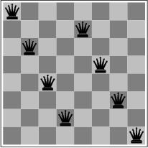
Local search and optimization
Previously: systematic exploration of search space.
Path to goal is solution to problem
YET, for some problems path is irrelevant.
E.g 8-queens
Different algorithms can be used
Local search

Slide 4
Local search and optimization
Local search
Keep track of single current state
Move only to neighboring states
Ignore paths
Advantages:
Use very little memory
Can often find reasonable solutions in large or infinite (continuous) state spaces.
“Pure optimization” problems
All states have an objective function
Goal is to find state with max (or min) objective value
Does not quite fit into path-cost/goal-state formulation
Local search can do quite well on these problems.

Slide 5
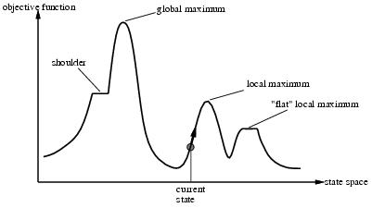
“Landscape” of search

Slide 6
Hill-climbing search
function HILL-CLIMBING( problem) return a state that is a local maximum
input: problem, a problem
local variables: current, a node.
neighbor, a node.
current ← MAKE-NODE(INITIAL-STATE[problem])
loop do
neighbor ← a highest valued successor of current
if VALUE [neighbor] ≤ VALUE[current] then return STATE[current]
current ← neighbor

Slide 7
Hill-climbing search
“a loop that continuously moves in the direction of increasing value”
terminates when a peak is reached
Aka greedy local search
Value can be either
Objective function value
Heuristic function value (minimized)
Hill climbing does not look ahead of the immediate neighbors of the current state.
Can randomly choose among the set of best successors, if multiple have the best value
Characterized as “trying to find the top of Mount Everest while in a thick fog”

Slide 8
Hill climbing and local maxima
When local maxima exist, hill climbing is suboptimal
Simple (often effective) solution
Multiple random restarts

Slide 9
Hill-climbing example
8-queens problem, complete-state formulation
All 8 queens on the board in some configuration
Successor function:
move a single queen to another square in the same column.
Example of a heuristic function h(n):
the number of pairs of queens that are attacking each other (directly or indirectly)
(so we want to minimize this)

Slide 10
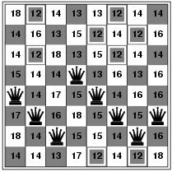
Hill-climbing example
Current state: h=17
Shown is the h-value for each possible successor in each column

Slide 11
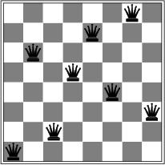
A local minimum for 8-queens
A local minimum in the 8-queens state space (h=1)

Slide 12
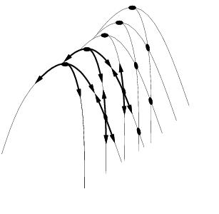
Other drawbacks
Ridge = sequence of local maxima difficult for greedy algorithms to navigate
Plateau = an area of the state space where the evaluation function is flat.

Slide 13
Performance of hill-climbing on 8-queens
Randomly generated 8-queens starting states…
14% the time it solves the problem
86% of the time it get stuck at a local minimum
However…
Takes only 4 steps on average when it succeeds
And 3 on average when it gets stuck
(for a state space with ~17 million states)

Slide 14
Possible solution…sideways moves
If no downhill (uphill) moves, allow sideways moves in hope that algorithm can escape
Need to place a limit on the possible number of sideways moves to avoid infinite loops
For 8-queens
Now allow sideways moves with a limit of 100
Raises percentage of problem instances solved from 14 to 94%
However….
21 steps for every successful solution
64 for each failure

Slide 15
Hill-climbing variations
Stochastic hill-climbing
Random selection among the uphill moves.
The selection probability can vary with the steepness of the uphill move.
First-choice hill-climbing
stochastic hill climbing by generating successors randomly until a better one is found
Useful when there are a very large number of successors
Random-restart hill-climbing
Tries to avoid getting stuck in local maxima.

Slide 16
Hill-climbing with random restarts
Different variations
For each restart: run until termination v. run for a fixed time
Run a fixed number of restarts or run indefinitely
Analysis
Say each search has probability p of success
E.g., for 8-queens, p = 0.14 with no sideways moves
Expected number of restarts?
Expected number of steps taken?

Slide 17
Expected number of restarts
Probability of Success = p
Number of restarts = 1 / p
This means 1 successful iteration after (1/p – 1) failed iterations
Let avg. number of steps in a failure iteration = f
and avg. number of steps in a successful iteration = s
Therefore, expected number of steps in random-restart hill climbing = 1 * s + (1/p – 1) f
So for 8-queens, p = 14%, s = 4, f = 3,
Expected no of moves = 1 * 4 + (1/0.14 -1) * 3 = 22
With sideways moves, p = 94%, s = 21, f = 64
Expected no of moves = 1 * 21 + (1/0.94 -1) * 64 = 25

Slide 18
Local beam search
Keep track of k states instead of one
Initially: k randomly selected states
Next: determine all successors of k states
If any of successors is goal → finished
Else select k best from successors and repeat.
Major difference with random-restart search
Information is shared among k search threads.
Can suffer from lack of diversity.
Stochastic beam search
choose k successors proportional to state quality.

Slide 19
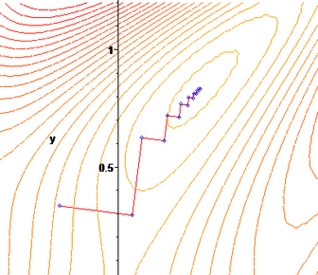
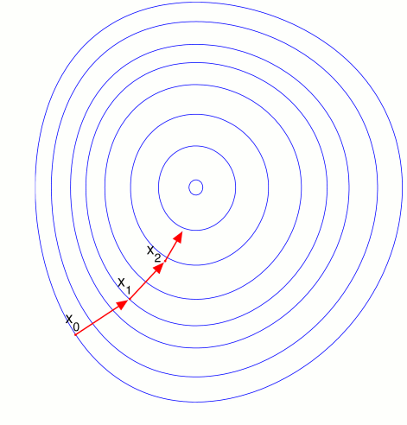
Gradient Descent
Assume we have some cost-function:
and we want minimize over continuous variables X1,X2,..,Xn
1. Compute the gradient :
2. Take a small step downhill in the direction of the gradient:
3. Check if
4. If true then accept move, if not reject.
5. Repeat.

Slide 20
Learning as optimization
Many machine learning problems can be cast as optimization
Example:
Training data D = {(x₁,c₁),………(x_{n}, c_{n})}
where x_{i} = feature or attribute vector
and c_{i} = class label (say binary-valued)
We have a model (a function or classifier) that maps from x to c
e.g., sign( w. x’ ) = {-1, +1}
We can measure the error E(w) for any settig of the weights w, and given a training data set D
Optimization problem: find the weight vector that minimizes E(w)
(general idea is “empirical error minimization”)

Slide 21
Learning a minimum error decision boundary

Slide 22
Search using Simulated Annealing
Simulated Annealing = hill-climbing with non-deterministic search
Basic ideas:
like hill-climbing identify the quality of the local improvements
instead of picking the best move, pick one randomly
say the change in objective function is δ
if δ is positive, then move to that state
otherwise:
move to this state with probability proportional to δ
thus: worse moves (very large negative δ) are executed less often
however, there is always a chance of escaping from local maxima
over time, make it less likely to accept locally bad moves
(Can also make the size of the move random as well, i.e., allow “large” steps in state space)

Slide 23
Physical Interpretation of Simulated Annealing
A Physical Analogy:
imagine letting a ball roll downhill on the function surface
this is like hill-climbing (for minimization)
now imagine shaking the surface, while the ball rolls, gradually reducing the amount of shaking
this is like simulated annealing
Annealing = physical process of cooling a liquid or metal until particles achieve a certain frozen crystal state
simulated annealing:
free variables are like particles
seek “low energy” (high quality) configuration
get this by slowly reducing temperature T, which particles move around randomly

Slide 24
Simulated annealing
function SIMULATED-ANNEALING( problem, schedule) return a solution state
input: problem, a problem
schedule, a mapping from time to temperature
local variables: current, a node.
next, a node.
T, a “temperature” controlling the probability of downward steps
current ← MAKE-NODE(INITIAL-STATE[problem])
for t ← 1 to ∞ do
T ← schedule[t]
if T = 0 then return current
next ← a randomly selected successor of current
∆E ← VALUE[next] - VALUE[current]
if ∆E > 0 then current ← next
else current ← next only with probability e^{∆E /T}

Slide 25
More Details on Simulated Annealing
Lets say there are 3 moves available, with changes in the objective function of d1 = -0.1, d2 = 0.5, d3 = -5. (Let T = 1).
pick a move randomly:
if d2 is picked, move there.
if d1 or d3 are picked, probability of move = exp(d/T)
move 1: prob1 = exp(-0.1) = 0.9,
i.e., 90% of the time we will accept this move
move 3: prob3 = exp(-5) = 0.05
i.e., 5% of the time we will accept this move
T = “temperature” parameter
high T => probability of “locally bad” move is higher
low T => probability of “locally bad” move is lower
typically, T is decreased as the algorithm runs longer
i.e., there is a “temperature schedule”

Slide 26
Simulated Annealing in Practice
method proposed in 1983 by IBM researchers for solving VLSI layout problems (Kirkpatrick et al, Science, 220:671-680, 1983).
theoretically will always find the global optimum (the best solution)
useful for some problems, but can be very slow
slowness comes about because T must be decreased very gradually to retain optimality
In practice how do we decide the rate at which to decrease T? (this is a practical problem with this method)

Slide 27
Genetic algorithms
Different approach to other search algorithms
A successor state is generated by combining two parent states
A state is represented as a string over a finite alphabet (e.g. binary)
8-queens
State = position of 8 queens each in a column
=> 8 x log(8) bits = 24 bits (for binary representation)
Start with k randomly generated states (population)
Evaluation function (fitness function).
Higher values for better states.
Opposite to heuristic function, e.g., # non-attacking pairs in 8-queens
Produce the next generation of states by “simulated evolution”
Random selection
Crossover
Random mutation

Slide 28
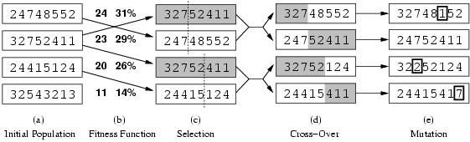
Genetic algorithms
Fitness function: number of non-attacking pairs of queens (min = 0, max = 8 × 7/2 = 28)
24/(24+23+20+11) = 31%
23/(24+23+20+11) = 29% etc
4 states for
8-queens
problem
2 pairs of 2 states randomly
selected based on fitness.
Random crossover points
selected
New states
after crossover
Random
mutation
applied

Slide 29
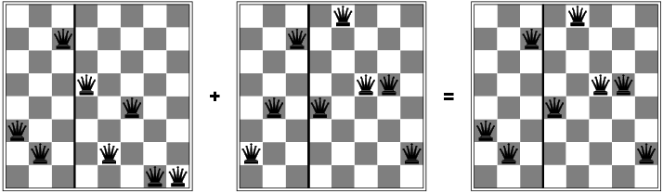
Genetic algorithms
Has the effect of “jumping” to a completely different new
part of the search space (quite non-local)

Slide 30
Genetic algorithm pseudocode
function GENETIC_ALGORITHM( population, FITNESS-FN) return an individual
input: population, a set of individuals
FITNESS-FN, a function which determines the quality of the individual
repeat
new_population ← empty set
loop for i from 1 to SIZE(population) do
x ← RANDOM_SELECTION(population, FITNESS_FN) y ← RANDOM_SELECTION(population, FITNESS_FN)
child ← REPRODUCE(x,y)
if (small random probability) then child ← MUTATE(child )
add child to new_population
population ← new_population
until some individual is fit enough or enough time has elapsed
return the best individual

Slide 31
Comments on genetic algorithms
Positive points
Random exploration can find solutions that local search can’t
(via crossover primarily)
Appealing connection to human evolution
E.g., see related area of genetic programming
Negative points
Large number of “tunable” parameters
Difficult to replicate performance from one problem to another
Lack of good empirical studies comparing to simpler methods
Useful on some (small?) set of problems but no convincing evidence that GAs are better than hill-climbing w/random restarts in general

Slide 32
Summary
Local search techniques and optimization
Hill-climbing
Gradient methods
Simulated annealing
Genetic algorithms
Issues with local search

